Slide 1


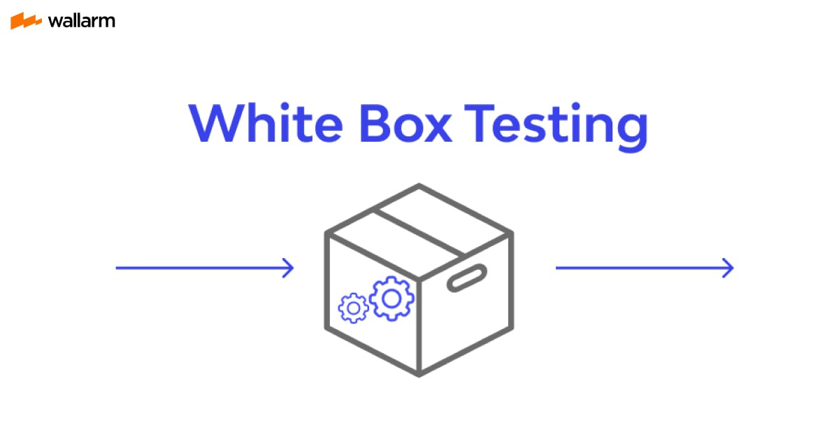
Faculty of Engineering & Computing, NUML
White Box Testing Techniques

Slide 2
Faculty of Engineering & Computing, NUML
Group Members:
Soma Nasir - 12322
Noor ud Din - 12293
Talib ul Moula - 12313
2

Slide 3
Faculty of Engineering & Computing, NUML
Objectives
Understand White Box Testing
Understand what to verify
Understand how to verify
Go Through the Techniques
Advantages and Disadvantages associated
4

Slide 4
Faculty of Engineering & Computing, NUML
White Box Testing
White box testing is a testing technique, that examines the program structure and derives test data from the program logic/code.
Internal structure
Design
Coding
5

Slide 5
Faculty of Engineering & Computing, NUML
White Box Testing
White box testing is also know as Glass Testing or Open Box testing. It is detailed examination of internal structure and logic of code.
This examination is demonstrated through test cases creation by looking at the code to detect any potential failure scenarios.
5

Slide 6
Faculty of Engineering & Computing, NUML
White Box Testing
White box testing utilizes the logical flow through a program to propose test cases.
Logical flow means the way in which certain parts of a program may be executed as we run the program.
Logical flow of a program can be represented by a Control Flow Graph (CFG).
5

Slide 7
Faculty of Engineering & Computing, NUML
How to Perform
UNDERSTAND THE SOURCE CODE
CREATE TEST CASES AND EXECUTE

Slide 8
Faculty of Engineering & Computing, NUML
White Box Testing Techniques

Slide 9
Faculty of Engineering & Computing, NUML
White Box Testing Techniques
Control Flow Graph
Statement Coverage
Decision Coverage / Branch Coverage
Condition Coverage

Slide 10
Control Flow Graph
Faculty of Engineering & Computing, NUML
How to Draw a Control Flow Graph
Number all the statements of a program
Numbered statements
Represent nodes of the flow graph
An edge from one node to another node exists
If execution of the statement representing the first node can result in transfer of control to the other node

Slide 11
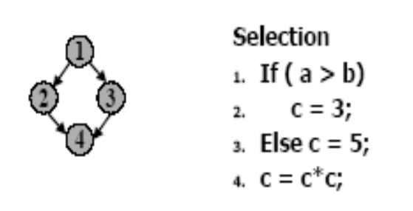
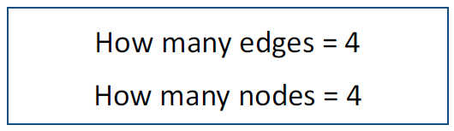
Control Flow Graph
(Example)
Faculty of Engineering & Computing, NUML

Slide 12
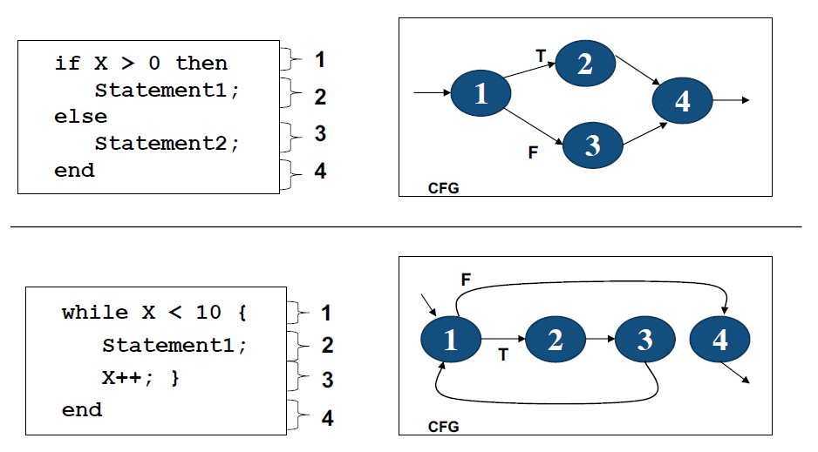
Control Flow Graph
(Example)
Faculty of Engineering & Computing, NUML

Slide 13
Faculty of Engineering & Computing, NUML
Statement Coverage
This technique requires every possible statement in the code to be tested at least once during the testing process of software engineering.

Slide 14
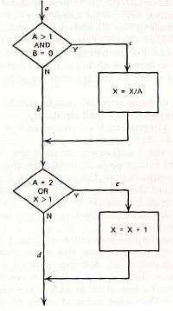
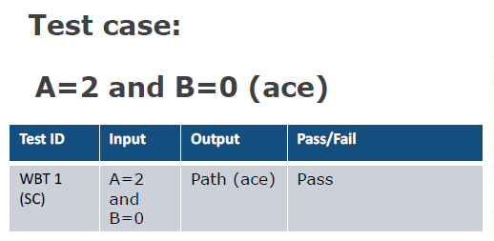
Statement Coverage
(Example)
Faculty of Engineering & Computing, NUML
Exercise all statements at least once

Slide 15
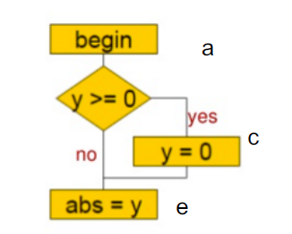
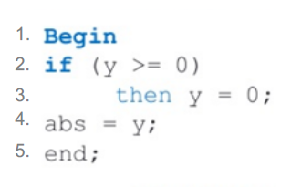

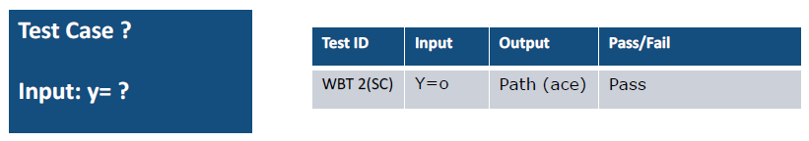
Statement Coverage
(Example)
Faculty of Engineering & Computing, NUML

Slide 16

Branch Coverage/ Decision Coverage
Faculty of Engineering & Computing, NUML
Branch coverage is a measure of the percentage of the decision points (Boolean expressions)
if
switch
while

Slide 17
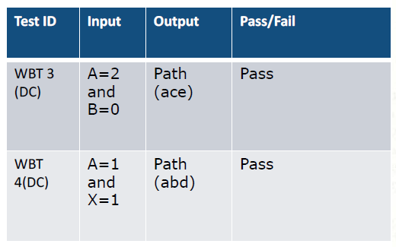
Branch Coverage/ Decision Coverage (Example)
Faculty of Engineering & Computing, NUML
Each decision has a true and false outcome at least once

Slide 18
Faculty of Engineering & Computing, NUML
Condition Coverage

Slide 19

Faculty of Engineering & Computing, NUML
Condition Coverage
The goal is to design test cases to ensure that each condition in a decision takes on all possible outcomes at least once.
Ensures that every condition within a decision is covered
Consider the conditional expression:
((c1 and c2)or c3)
Each of c1, c2, and c3 are exercised at least once,
i.e. given true and false values require 23 test cases.
29

Slide 20
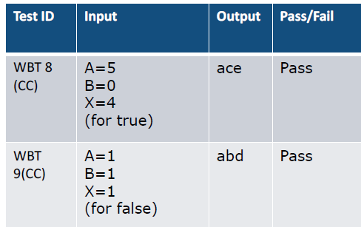
Condition Coverage (Example)
Faculty of Engineering & Computing, NUML
Each condition in a decision takes on all possible outcomes at least once
Conditions: A>1, B=0, A=2, X>1

Slide 21
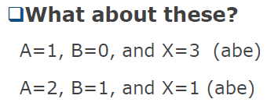
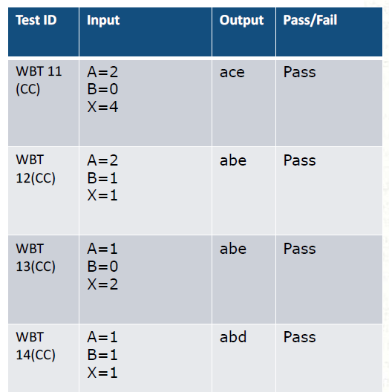
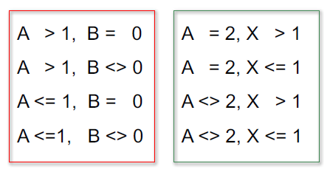
With multiple conditions
Faculty of Engineering & Computing, NUML
Exercise all possible combinations of condition outcomes in each decision
Conditions:
30

Slide 22
Faculty of Engineering & Computing, NUML
Advantages of White Box Testing:
When the tester is knowledgeable, it becomes easy to find loop holes.
Extra Lines of code are removed.
Maximum Coverage.
It helps in code optimization.
38

Slide 23
Disadvantages of White-Box Testing:
White box testing is too much time consuming when it comes to large-scale programming applications.
It is too much expensive and complex.
It can lead to production error.
Changing in the code requires all the scenarios to be tested again.
45

Slide 24
Faculty of Engineering & Computing, NUML
Advantages of Control Flow Testing
It detects almost half of the defects that are determined during the unit testing.
It also determines almost one-third of the defects of the whole program.
It can be performed manually or automated.
40

Slide 25
Advantages of Statement Coverage
It measures the quality of code.
It checks the flow of different paths in the program and it also ensure that whether those path are tested or not.
42

Slide 26
Faculty of Engineering & Computing, NUML
Disadvantages of Statement Coverage:
It cannot test the false conditions.
It does not understand the logical operators.
It does not report that whether the loop reaches its termination condition.
47

Slide 27
Faculty of Engineering & Computing, NUML
Advantages of Branch Coverage
To validate that all the branches in the code are reached
It eliminate problems that occur with statement coverage testing
43

Slide 28
Disadvantages of Branch Coverage:
It is more costly to accomplish branch testing in software testing.
It ignores branches within Boolean expressions which occur due to short-circuit operators.
Accomplishing branch scope requires the generation of a bigger number of test cases.
49

Slide 29
References:
Faculty of Engineering & Computing, NUML
Articles
https://students.cs.byu.edu/~cs340ta/spring2019/readings/WhiteBox.pdf
Website Reference
https://www.guru99.com/code-coverage.html
https://www.geeksforgeeks.org/statement-coverage-testing/
https://www.educba.com/branch-coverage/#:~:text=Branch%20Coverage%20(%25)%20%3D%203%2F3,branching%20for%20functional%20looping%20statements.
53

Slide 30

Faculty of Engineering & Computing, NUML
54

